Slide 1
Peter John M.Phil, PhD Atta-ur-Rahman School of Applied Biosciences (ASAB) National University of Sciences & Technology (NUST)

Slide 2
DNA Supercoiling
Efficiency of some promoters is influenced by the degree of Supercoiling
Twin Model of Transcription
Transcription complex rotate around the DNA
DNA itself rotate around complex

Slide 3
DNA Supercoiling
As RNA Pol push forward along the DNA it generate +ve supercoil (DNA gyrase is involved in this step)
RNA Pol generate/leave negative supercoil behind it (Topoisomerase is involved in this)
Transcription have a significant effect on the local structure of DNA

Slide 4
DNA Supercoiling

Slide 5
Sigma Factor Substitution
There are more than one type of sigma factors, each specific for different type of promoter
Substitution of one sigma factor changes the choice of promoters
Consensus seq for each set of promoter are different from one another
Substitution of sigma factor can turn off transcription of one set of gene & turn on other genes

Slide 6
Sigma Factors under different cond.

Slide 7
Sigma Factor-DNA Contact
Sigma factor make critical contact with promoter seq in the vicinity of -35 & -10
Several bacterial sigma factors have conserved regions which fold into 3 independent domains

Slide 8
Sigma Factor-Three Domains
Contact RNA Polymerase
Required for melting the DNA
Contact -10 & -35 promoter seq

Slide 9
Sigma Factor-DNA Contact
If N terminal of sigma 70 is removed it can bind to DNA
N-terminal block the DNA binding region to bind to DNA but when sigma factor binds to core polymerase, N-terminal swing and allow this region to bind to DNA

Slide 10
Sigma Factor-DNA Contact

Slide 11
Sigma Factor-Cascade
Cascade of sigma factor is created when one sigma factor is required to transcribe the gene coding for the next sigma factor
Transcription of SPO1 phage is controlled by successive substitution of 2 sigma factor

Slide 12
SPO1 Sigma Factor-Cascade
SPO1 early gene encoded by host holoenzyme
Early gene 28 code a sigma factor that displace host sigma factor
Middle gp28-core enzyme, transcribe phage middle gene
Middle genes 33 & 34 code for protein that displace gp28
Late gp33-gp34-core enzyme transcribe late genes

Slide 13
SPO1 Sigma Factor-Cascade

Slide 14
SPO1 Sigma Factor-Cascade
Early
σ⁷⁰
σ²⁸
middle
σ^{33,34}
late

Slide 15
Bact RNA Pol Terminator
Two types of features found in bacterial terminators
(i) The responsibility for termination lies with the seq already transcribed by RNA polymerase, so it relies on template/product
(ii) Many termination require a hair pin to form in the secondary, so termination depends on the RNA product

Slide 16
Two Types of Terminator
Intrinsic: Core enzyme can terminate at certain sites in the absence of any other factor. This include palindromic seq that form hair pin (7-20bp)
Rho-depended: Rho factor binds to RNA at rut site (C rich & G poor) tranaslocate along this until reaches RNA-DNA hybrid to separate RNA

Slide 17
Rho-depended rut site

Slide 18
Rho-depended

Slide 19
Rho-depended

Slide 20
Intrinsic Terminator
Intrinsic terminators include palindromic regions that form hairpins varying in length from 7-20 bp.
The stem loop structure includes a G-C rich region and is followed by a run of U residues

Slide 21
Intrinsic Terminator

Slide 22
Promoters & Enhancers

Slide 23
Promoters & Enhancers
Transcription Factor:
Any protein that is needed for the initiation of transcription.
TF may recognize other factors, proteins & RNA polymerase to incorporate into initiation complex

Slide 24
Eukaryotic Transcription
Promoter is the region containing all these sites
Initiation of eukaryotic transcription involves a large number of factors that binds to a variety of cis-acting elements.
In eukaryotes TFs recognize the promoter seq

Slide 25
Prokaryotic Transcription
In bacteria RNA polymerase recognize the promoter seq
The bacterial promoter is the binding site for RNA polymerase, which is in the immediate vicinity of start point

Slide 26
RNA Polyemerases
RNA Polymerase I transcribe rRNA
RNA Polymerase II transcribe mRNA
RNA Polymerase III transcribe tRNA & small RNAs

Slide 27
Basal Transcription Apparatus
TFs for RNA Pol II form a complex called Basal
Basal + RNA Pol II is called basal Transcription Complex

Slide 28
Enhancers
A sequence that stimulate initiation but are located considerable distance from start point.
Protein bound at enhancer seq interact with proteins bound at promoter

Slide 29
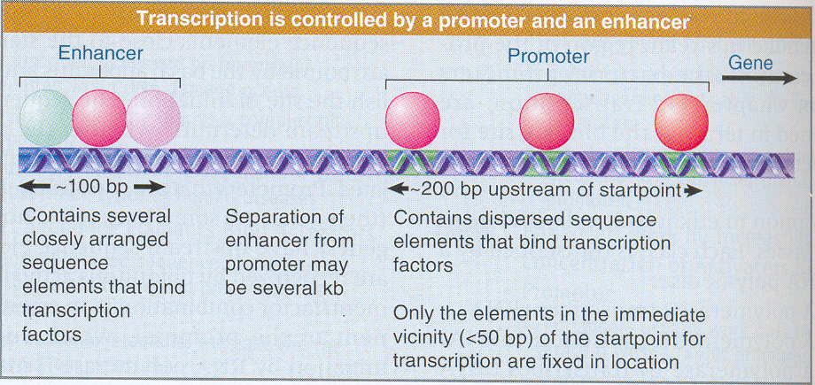

Slide 30
Eukaryotic RNA Pol Sub Units
Three RNA polymerases have different locations in the nucleus
RNA Pol I most predominate in the nucleolus
RNA Pol II is major enzyme in the nucleoplasm
RNA Pol III minor enzyme in nucleoplasm

Slide 31
Eukaryotic RNA Pol Sub Units
All eukaryotic RNA Polymerases have size of >500 KDa & have 12 subunits
The largest subunit in RNA Pol II is carboxy terminal Domain (CTD) which consist of multiple repeats of consensus sequence of seven amino acids
There are ~26 repeats in yeast & ~50 repeats in mammals
CTD is involved in initiation reaction

Slide 32
Thanks

